Slide 1
Study on Machine Learning approach using Fingerprint Recognition system
Fatema Tuz Zohora 22366015
Md. Shajeebul Islam Sk. 22366027

Slide 2
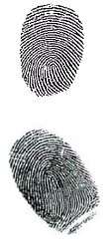
Features of Fingerprint
Fingerprints are imprints formed by friction ridges of
the skin in fingers and thumbs.
The pattern are permanent and unchangeable on each
finger during all the life.

Slide 3
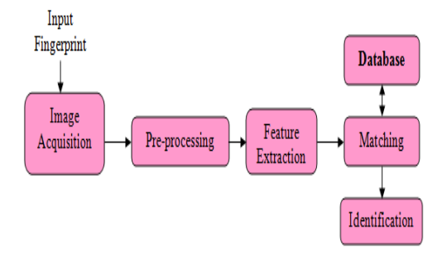
The Pattern Recognition System
Figure : Finger print recognition system

Slide 4
Why Using Neural Network
Neural network enable solutions to be found to problems where algorithmic methods are too computationally intensive on do not exist.
The problem of feature extraction and classification seems to be a suitable application for neural network.
They offer significant speed advantages over conventional technique.

Slide 5
The goal of this method
This proposed method is based on a data model for fingerprints structural rather than coordinate.
The structural data model is robust with respect to translation, rotation and distortion.

Slide 6
Thank you

